Slide 1


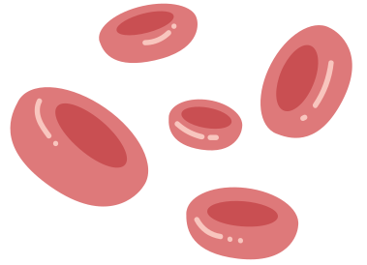
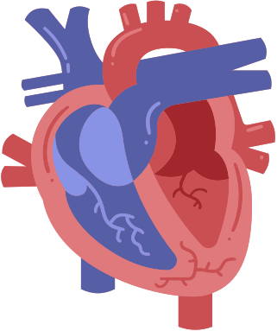


HEART FAILURE PREDICTION SYSTEM

Slide 2



OUTLINE :
Introduction
Objectives
Data Set
Visiualization
Data PreProcessing
Model Implementation
Results
Conclusion

Slide 3




INTRODUCTION
Cardiovascular diseases (CVDs) are the number 1 cause of death globally, taking an estimated 17.9 million lives each year, which accounts for 31% of all deaths worldwide.
1
Supervised learning is a category of machine learning that uses labeled datasets to train algorithms to predict outcomes and recognize patterns
2
Heart failure is a common event caused by CVDs and this dataset contains 17 features that can be used to predict a possible heart disease
3

Slide 4



OBJECTIVES :
Data visualization
Data Preprocessing
Data Analysis
Label Encoding
Feature Selection.
Splitting of the dataset
machine learning model
prediction results on test data

Slide 5
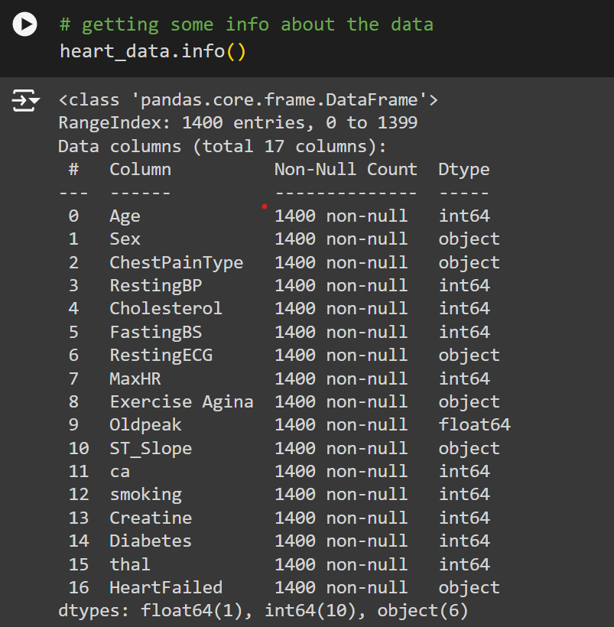
DATASET :

Slide 6
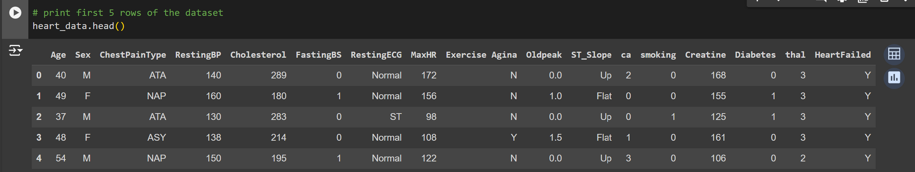
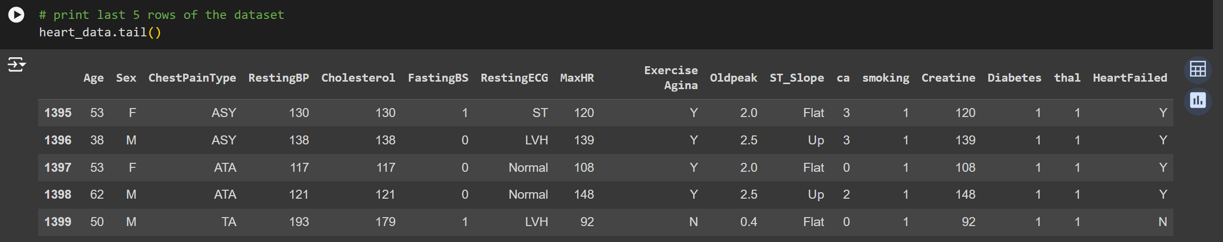
FIRST 5 ROWS
LAST 5 ROWS

Slide 7
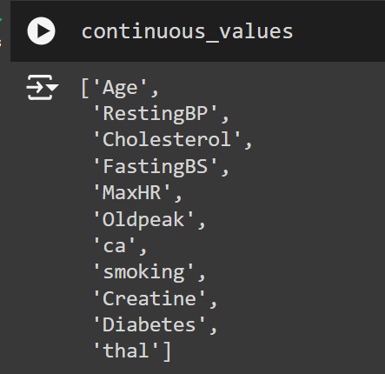
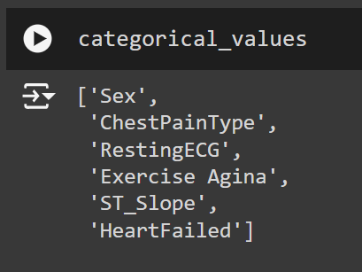
CATEGORICAL VALUES
CONTINOUS VALUES

Slide 8
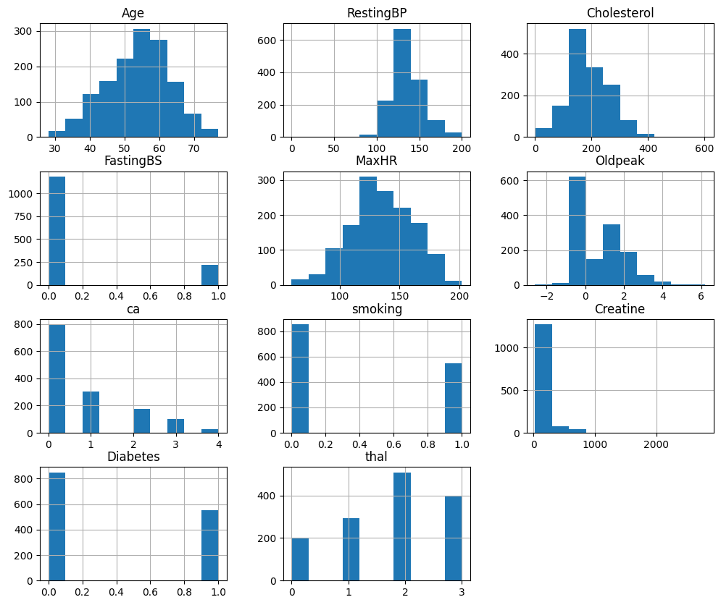
VISIUALIZATION
Visualizing the continuous values
Data visualization is the graphical representation of information and data. By using visual elements like charts, graphs, and maps, data visualization tools provide an accessible way to see and understand trends, outliers, and patterns in data

Slide 9
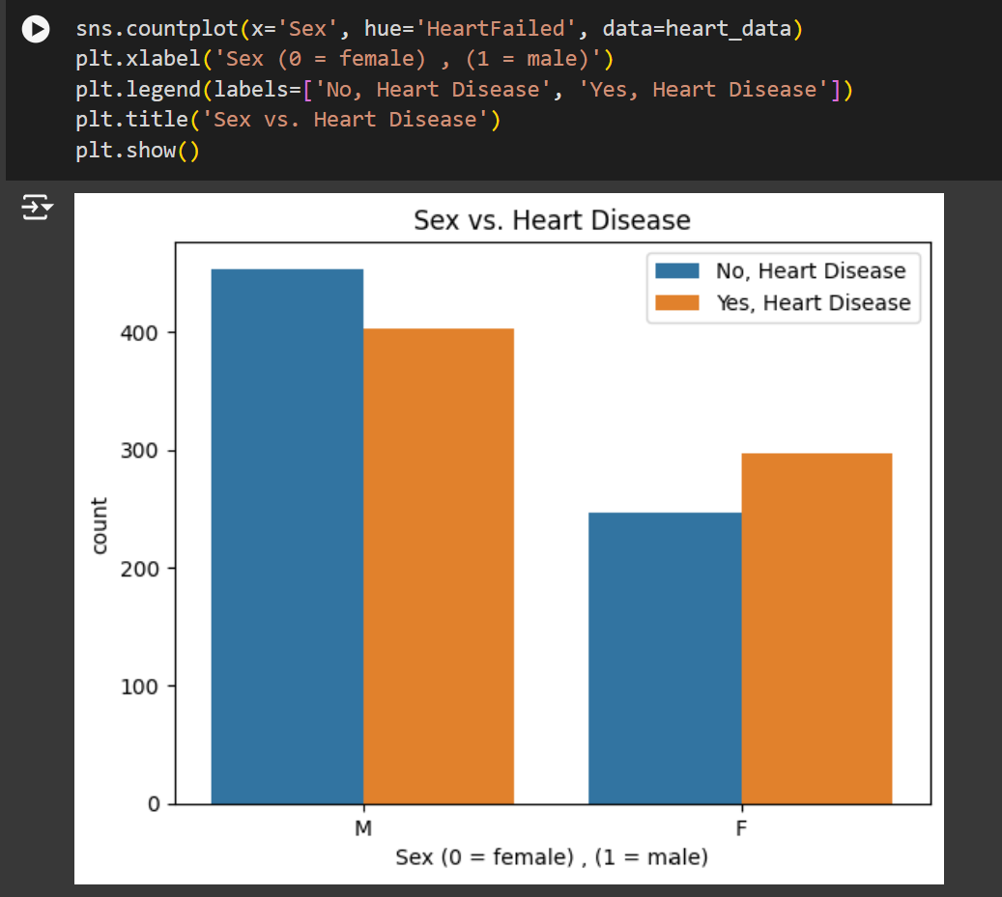
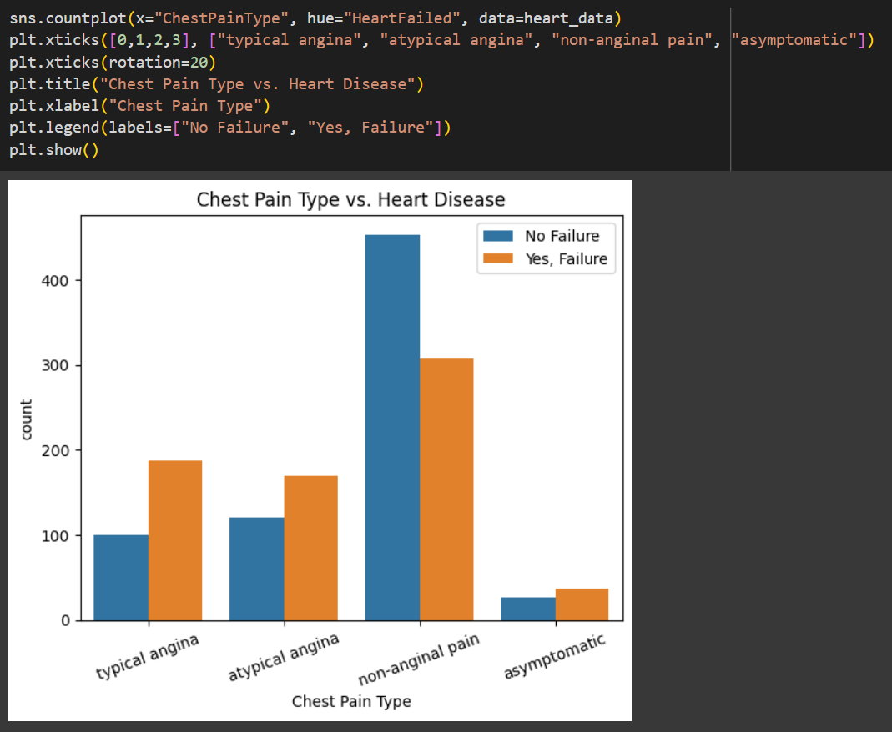
VISUALIZING "CHESTPAINTYPE" ATTRIBUTE VS "HEART FAILED" BY COUNTPLOT
VISUALIZING "SEX" ATTRIBUTE VS "HEART FAILED"

